Slide 1
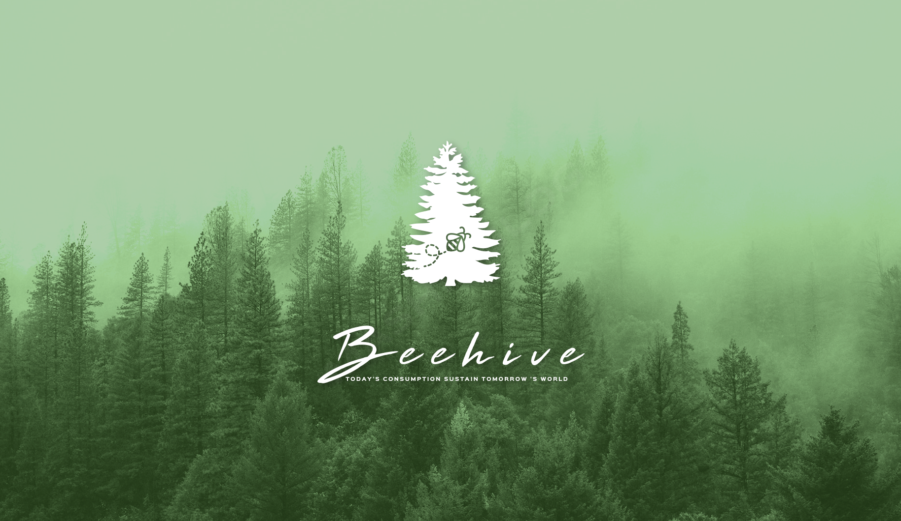
z

Slide 2
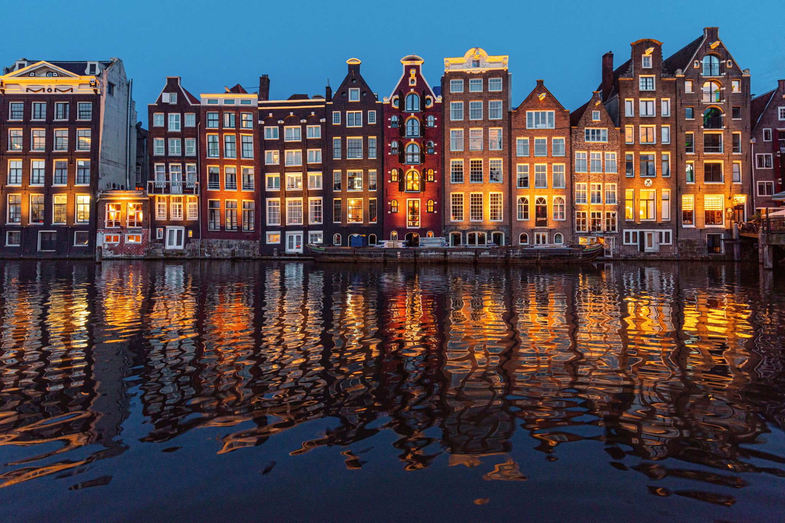
Our story begins with a vision that aims to create opportunities for environmental education. We strive to promote education’s power in changing lives. At the heart of our mission, live our values for innovation and empowerment. The concept of BEEHIVE is all about spreading and preserving the principles of sustainability and environmental conservation. “Amsterdam”, the Dutch capital of the Kingdom of the Netherlands was introduced as one of the world’s most eco-friendly cities and greenest spots. We are proud to call Amsterdam our home, a city that is known for its eco-friendly policies and sustainable practices. Amsterdam is a testament to what can be achieved when people come together to protect the environment, and we are inspired by the spirit of the city and its residents. BEEHIVE is a permanent campaign, that is set on reminding the world to save our planet and take into consideration the wellbeing of the earth. It is crucial to incite inspiration in people, so they achieve their part in saving the planet. We need to get them thinking about our individual and collective impact on the world we live in. Do what you can, when you can.
z

Slide 3
We are deeply committed to the principles of sustainability and environmental conservation.
We are dedicated to reducing single-use plastic and offering the most advanced products,
We believe in sustainable practices and strive to make a positive impact on the environment.
We supply and export all types of eco-friendly materials to help businesses and startups across the globe protect the environment and promote their brand quickly.
We are focused on providing eco-friendly solutions to protect the environment and promote sustainability.
We understand the importance of being recognized as an earth-friendly brand and strive to offer our clients the best eco-friendly products and services to help them achieve their goals.
We are driven by our values for creating an eco-friendly world and making our clients successful. We have the courage to make a positive impact and keep the world in its best shape.

Slide 4
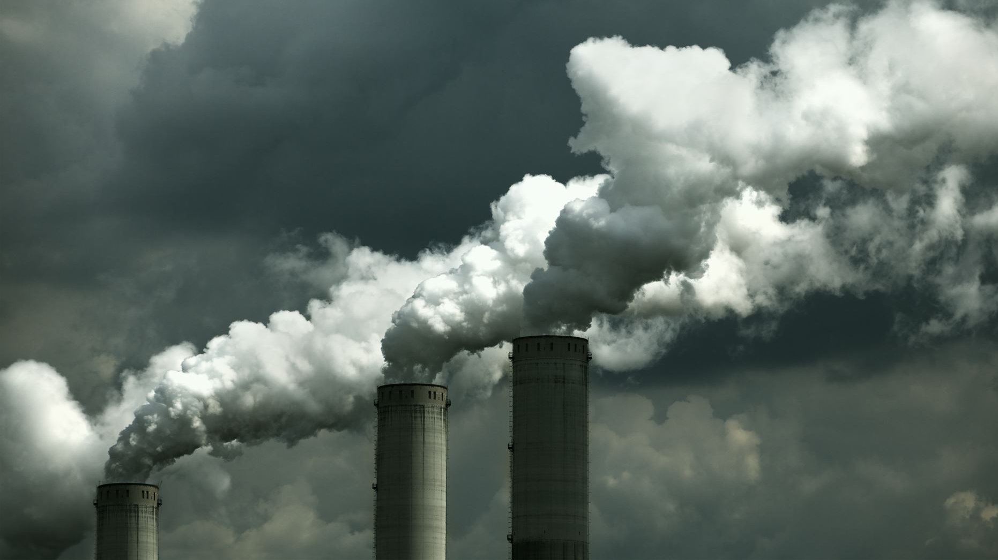
Pollution is a critical environmental problem that humanity is and will face in the upcoming decade. It is becoming an increasingly dangerous threat. It can trigger various environmental catastrophes, such as global warming, ozone layer depletion, and climate change. These issues jeopardize the planet and our well-beings.
Global warming, caused by the depletion of the ozone layer, is the primary cause of our world's most pressing threat. It leads to increased UVB radiation reaching the Earth's surface, plants harm to human health and the environment. High temperatures, prolonged heat waves, wildfires, droughts, shrinking of the Arctic ice, rising sea levels, changes in seasons, and alterations in rainfall patterns are all consequences of global warming. These effects are widespread and present a great menace to our planet and way of life.
Natural disasters such as earthquakes, tsunamis, and typhoons can also result from global warming, leading to extensive flooding and other devastating consequences. Volcanic eruptions can be unpredictable and have severe consequences, including contamination of drinking water and the spread of new diseases.
As previously mentioned, the consequences of pollution on humans are severe and deathly. Climate refugees are forced to leave their homes due to the effects of climate change and global warming. Contamination of drinking water, water supply problems, and the harm caused to DNA, skin, and eye health can lead to respiratory illnesses such as asthma, and even cancer. These impacts are not limited to human health, as they can also trouble one’s quality of life, with reduced living standards and significant economic losses, which brings us back to our objective. We must spread awareness and educate people about these menaces and urge them to be more caring towards the environment. That way, they would also be protecting themselves from the risk of becoming ill.

Slide 5
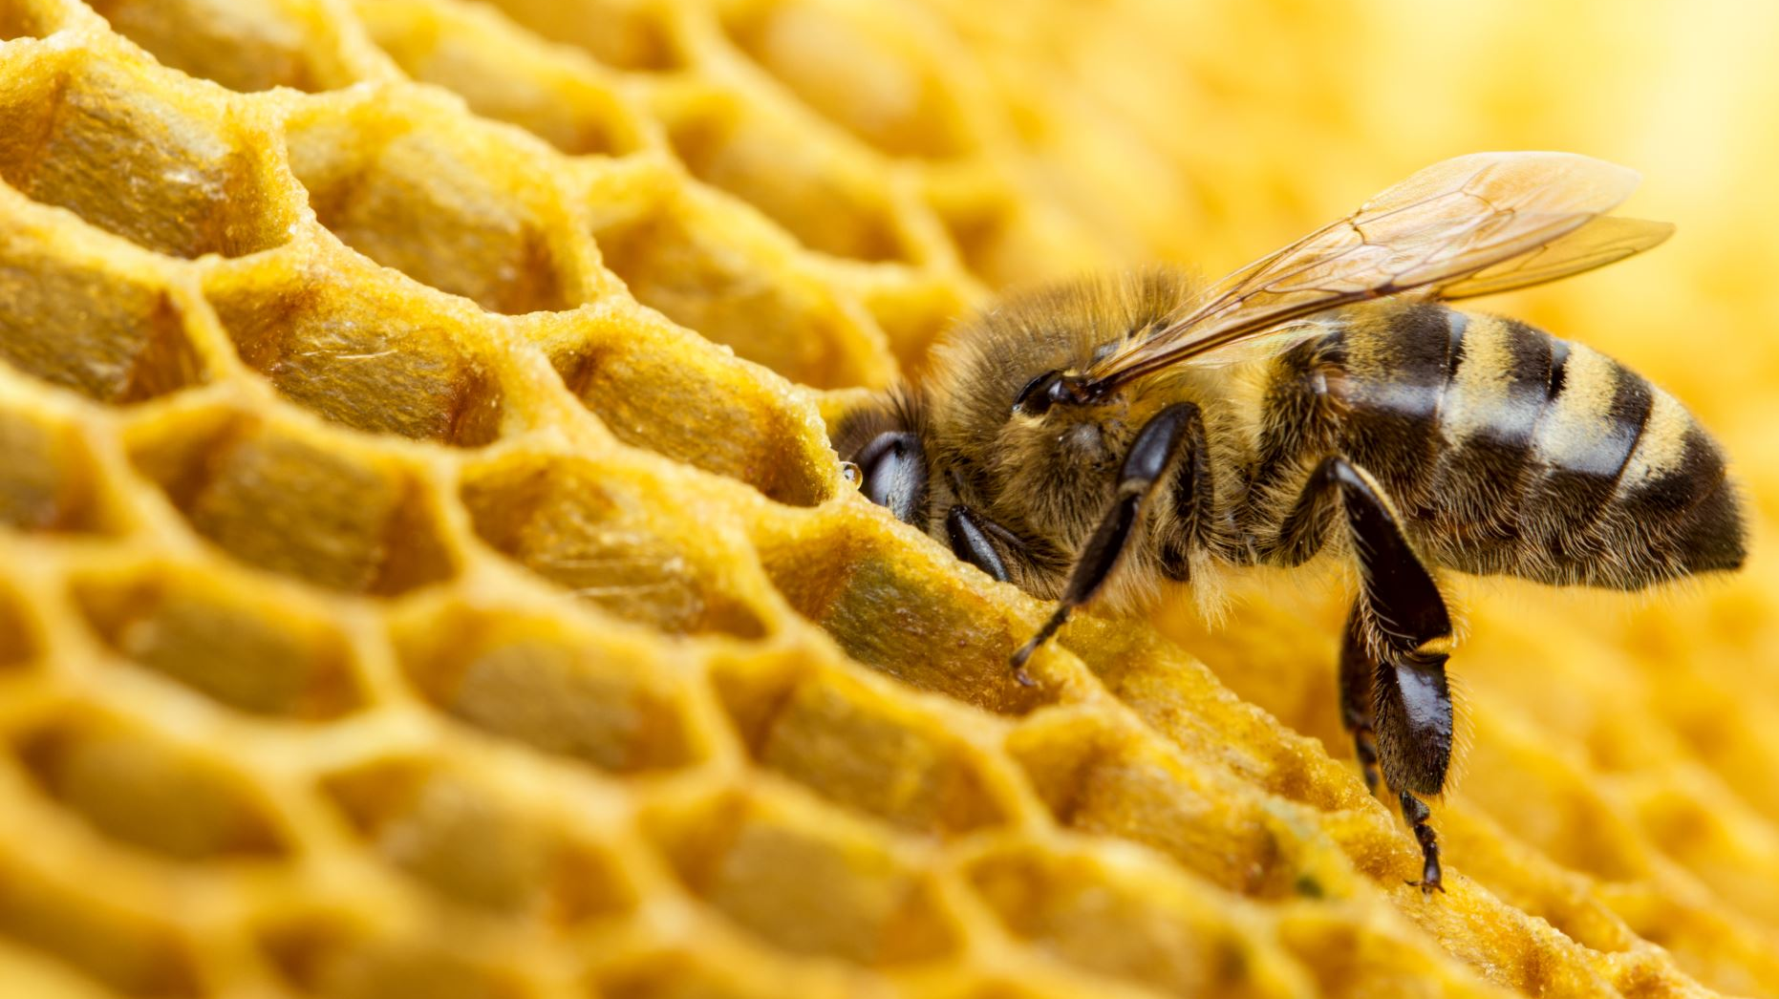
The symbolism of bees stems from their rich history, culture and significance to human life. The bee symbolizes community, continuance, and regeneration, and has been revered throughout history for its industriousness, wisdom, and strength. The hive life is a powerful symbol of organization, efficiency, and productivity, and has been used to represent these qualities in a variety of cultures and belief systems.
In many ancient cultures, bees were seen as messengers of the divine, carrying news and inspiration from the divine realm to humanity. In Judaism, the bee is seen as a symbol of wisdom and industriousness. In Christianity, the bee has been likened to the attributes and characteristics of Jesus Christ himself, and is seen as a symbol of his wisdom, strength, and productivity. It is widely mentioned in the bible. In Islam, bees are also deemed as sacred. There is a verse from the Quran called “sourate al Nahla”, which translates to ‘The Bee’. It says, “your Lord inspired the bee, saying ‘Build yourselves houses in the mountains and trees. There truly is a sign in this for those who think”.
Bees are present in the creation of myths, and sacred places of ancient cultures. The hive life is a powerful symbol of community, continuance, and regeneration. Bees have been used to represent positivity in a variety of forms: wisdom, immortality, and fidelity, They have played a vital role throughout the centuries and continue to help mankind. Mayan Culture is one of the ancient cultures that use a form of humming, based on the sound of bees, in their trance-inducing and healing chants. The life-protecting hum of the bee is believed to be the essential sound of the universe in Hindu cosmology. That is perhaps the thread connecting all energy together.
Bees are very industrious and productive. They keep their hives clean and eliminate any garbage. They work in an organized system. Despite there being hundreds and thousands of bees in a single colony, they are able to work efficiently because they stick to their roles. Each bee has a specific role to play and they stay dedicated to it.
The Beehive symbolism is a powerful reminder to work together in an organized and efficient manner towards a common goal. Bees are also a perfect example of how we should all commit to our role in caring for the environment for a better and safer future.

Slide 6
Trees, the lungs of the Earth, are man's best allies in the natural world, and they are truly amazingly efficient machines—constantly working to make Earth a healthier planet and serve as screens that reduce pollution. They show infinite potential for humans by providing oxygen, improving water quality, reducing flooding and erosion, possessing a cooling effect by lowering air temperatures and humidity, and influencing wind speed. They create the conditions that foster a healthier ecosystem. They have amazing potential for growth and improvement, which is why they should be protected and nurtured at all cost for our benefits. Wherever there is trees, wildlife and other plants, be sure to follow and ensure a healthier ecosystem. Trees provide shelter and food for a variety of birds and small animals. They generate an atmosphere that fosters a true regeneration of the ecosystems we have damaged, thereby providing hope and the promise of new life to the inhabitants of our planet. Trees improve health. they have an amazingly positive effect on our wellbeing. Exposure to trees has a relaxing effect on humans, reducing stress and imparting a sense of well-being.
By reconnecting ourselves with nature, trees help us reconnect with our inner selves. It is a sacred gift that releases our spirituality. Trees can also enhance a community’s sense of pride, and ownership, which also promotes environmental responsibility and ethics.
Trees standing is a symbol of resistance to time itself and a celebration of the mystery of life, which will continue to hold us in its spell for centuries to come. Let us continue to work towards a sustainable future that represents a precious opportunity for mankind.

Slide 7
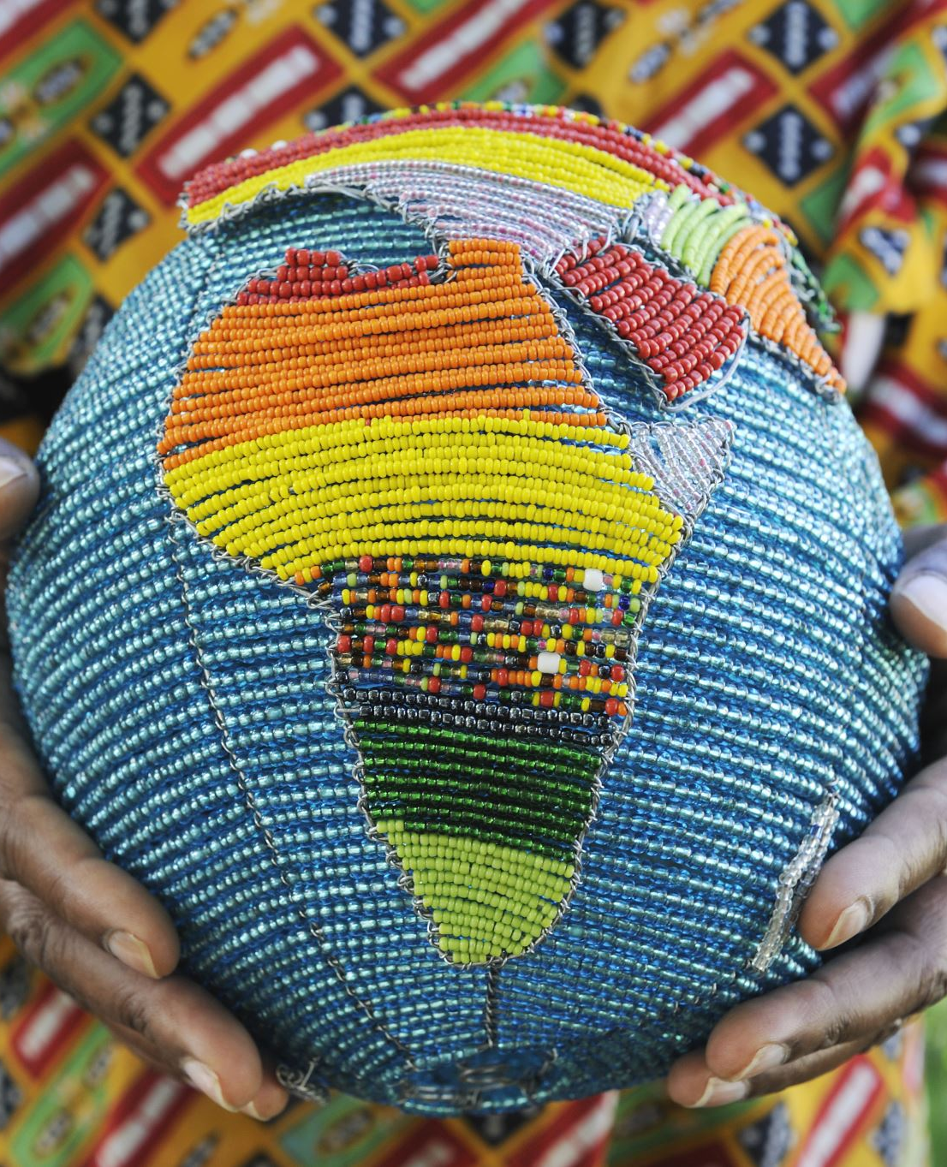
Together,
we can make a difference
We believe that the Earth is a precious gift, and it is up to all of us to do our part in protecting it. We are committed to making a difference and leaving a better world for future generations. Whether it is through our products, our campaigns, or our daily actions, every small action we take can have a big impact on the planet, and we are committed to promoting environmental awareness and sustainable practices in all that we do.

Slide 8
The Beehive is a project that is deeply committed to the principles of sustainability and environmental conservation. Our mission is to inspire people to act and protect the planet, and we believe that everyone has a role to play in this effort.
Consumers who prioritize sustainability and ethical practices.
Beehive's products are crafted using only the highest quality materials that are also eco-friendly.
In addition to our commitment to sustainability, Beehive is also dedicated to supporting local communities and promoting fair trade practices. They work directly with small artisanal groups to create their products, ensuring that each piece is made with care and attention to detail.
Beehive has something to offer. Their value for quality, sustainability, and ethical practices sets them apart from other brands and makes them a great choice for conscious consumers.

Slide 9
Disposable cutelury
Biodegradable cutlery is a type of cutlery made from materials that can be broken down and decomposed naturally in the environment. This type of cutlery is an alternative to traditional plastic cutlery, which can take hundreds of years to decompose and harm the environment.
Biodegradable cutlery is made from materials such as wood, which are renewable and sustainable resources. These materials are compostable and can break down into natural elements, such as carbon dioxide, water, and biomass, without releasing harmful toxins into the environment.
Using biodegradable cutlery is an easy way to reduce your environmental impact and promote sustainable practices. By switching to biodegradable cutlery, you can help reduce the amount of plastic waste that ends up in landfills and oceans, and contribute to a cleaner and healthier planet.
Beehive is set on promoting sustainable practices and providing eco-friendly solutions to help businesses and individuals reduce their environmental impact. We offer a range of biodegradable cutlery products, including , spoons, forks, and knives, that are perfect for any occasion. Join us in our mission to create a better world and protect the environment.

Slide 10
Let your brand name combined with Beehive take your business to the next level. Ecofriendly Branding Made Easy For You.
Promote your brand and increase brand awareness quickly by creating a unique identity for it globally. Build trust With eco-friendly custom designs. Be recognized as earth's most compelling and respected eco-friendly brand where clients can get eco-friendly products. When people see your environmentally friendly approach, they will appreciate you. It will help you provide a solution for those who come with a problem. It will make your brand popular worldwide, increase your brand visibility, get you more customers and boost your sales.

